Slide 1
Year 1
Baslow St Anne’s CofE Primary School
Kindness – Respect - Diversity

Slide 2
Timetable
Daily :- Collective worship , playtimes
Monday to Thursday :- Maths, Phonics
Monday :- Topic , PSHE
Wednesday :- Outdoor Games, music
Thursday :- Science
(Summer term Friday morning :- Woodland Explorers)
Special days and events eg science week, Children in Need, trips, sports etc

Slide 3
Year 1 Curriculum

Slide 4
Phonics
Continue with our scheme Little Wandle www.littlewandle.org.uk>resources>for-parents
Revisit and consolidate EYFS phonics (see pack) (phases 3 and 4)
Start on alternative sounds (26 letters = 44 sounds (phonemes) = c.250 graphemes (see pack) (phase 5)
Phonics games :- ICT / Phonics Play / Phonics Bloom / Top marks / Alphablocks (links to be sent in email)
Year 1 phonics screening (June 2027) information nearer time

Slide 5
Tricky Words (Sight Words)
3 groups – EYFS sets 1 – 9
- Year 1 sets 10 – 18 + sets 19 -26
Certificates – 1-3, 4+5, 6-9, 10 -18, 19-26 (lucky dip)
Sets 10 – 26 – come home on a sheet – practise at home – games, tested in school and advised which next set to do

Slide 6
Reading
* Little Wandle group reading in school – diary
* Home readers – stages 1 – 5 – Daily read and change
- stages 6 and above – c.4 books per week on a Monday kept at home and changed weekly
* Reading = decoding, comprehension, fluency, expression

Slide 7
Spellings
Follow phonics Little Wandle
Friday to Friday – test, stickers, positive
Example of sheet – 12 spellings ( alternatives if needed)
(See next slide)
Ways to practise – look and say writing or alternative ways (email to be sent with links)

Slide 8




Y1 Spellings – Remember there are 8 words that can be decoded by blending their sounds. This week the graphemes (written version of a sound) to look out for are :- ee oo(short) oo (long) or ow igh ar ear. Help your child spot these in the words. There are also 4 sight words which can’t be decoded phonetically but need to be learnt as a whole (sight words). There will be a spelling test on Friday ( not in the same order as below) and then your child will bring home the new spelling sheet for the following week. Try to practise every day rather than once a week! Please ask if you want any further help.
Look and say | Look and write | Cover and write | Day 2 | Day 3 | Day 4 | Day 5 | Day 6
feel
food
sort
down
right
hard
took
hear
go
my
into
out

Slide 9
PLEASE BRING THIS SHEET TO SCHOOL ON A FRIDAY
Test Date:
Score out of 12 =
1. | 2 | 3 | 4

Slide 10
Maths
White Rose maths – lots of practical but do start to record
At home – board games, continue from EYFS activities, also see links to variety online games and activities (links to be sent in email)
Over this year aim :- Number bonds to 10 then 20 ( certificates in school)

Slide 11
ILP (Independent Learning Project)
3 over the year
To do at home – to bring enjoyment of learning, develop creativity, strengthen partnerships, confidence in speaking and presenting
Usually topic related – choice of activities
Bring to school for an approximate 1 minute presentation to peers and adults

Slide 12
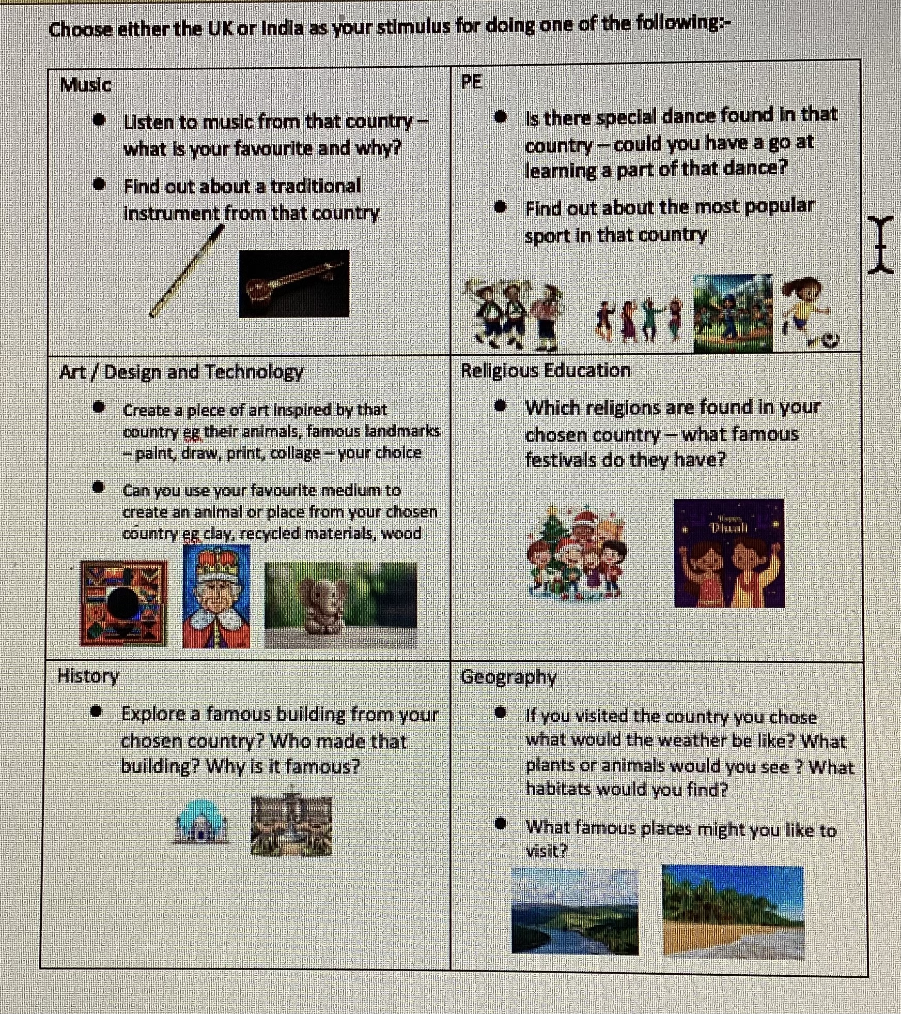
Year 1 ILP (Independent Learning Project) Spring Term 2026

Slide 13
How to help at home
DAILY :- reading home books
spellings
sight word practise (if applicable)
recap phonic cards (if asked in reading diary)
WEEKLY :- phonic games / maths games
TERMLY :- ILP (3 x year)
AS ALWAYS – ANY QUESTIONS PLEASE JUST ASK ☺

